Slide 1
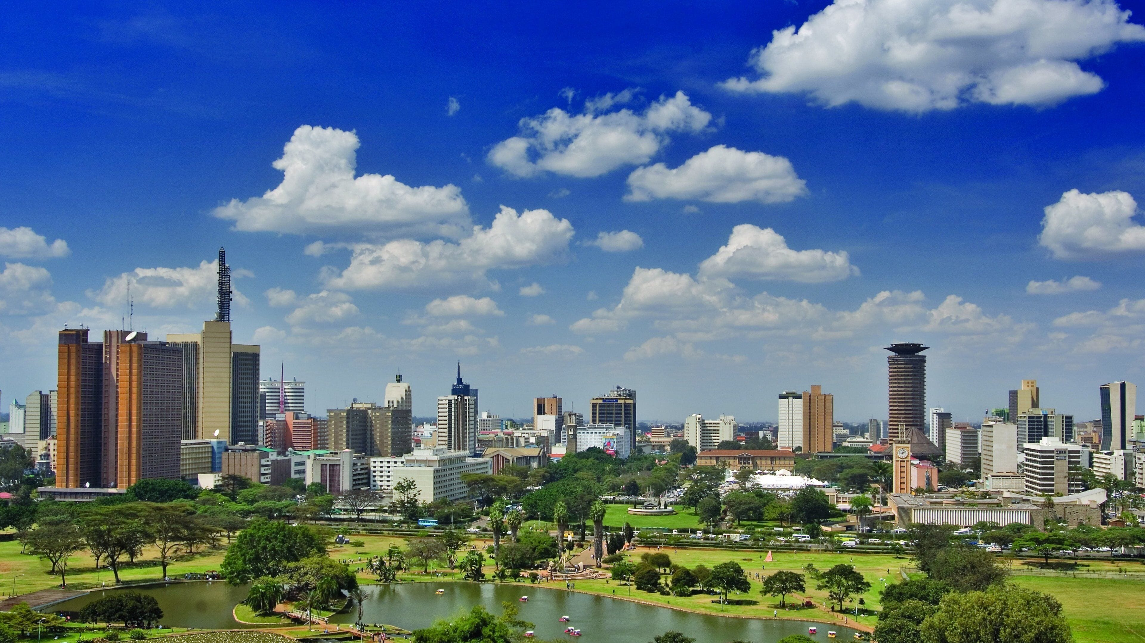
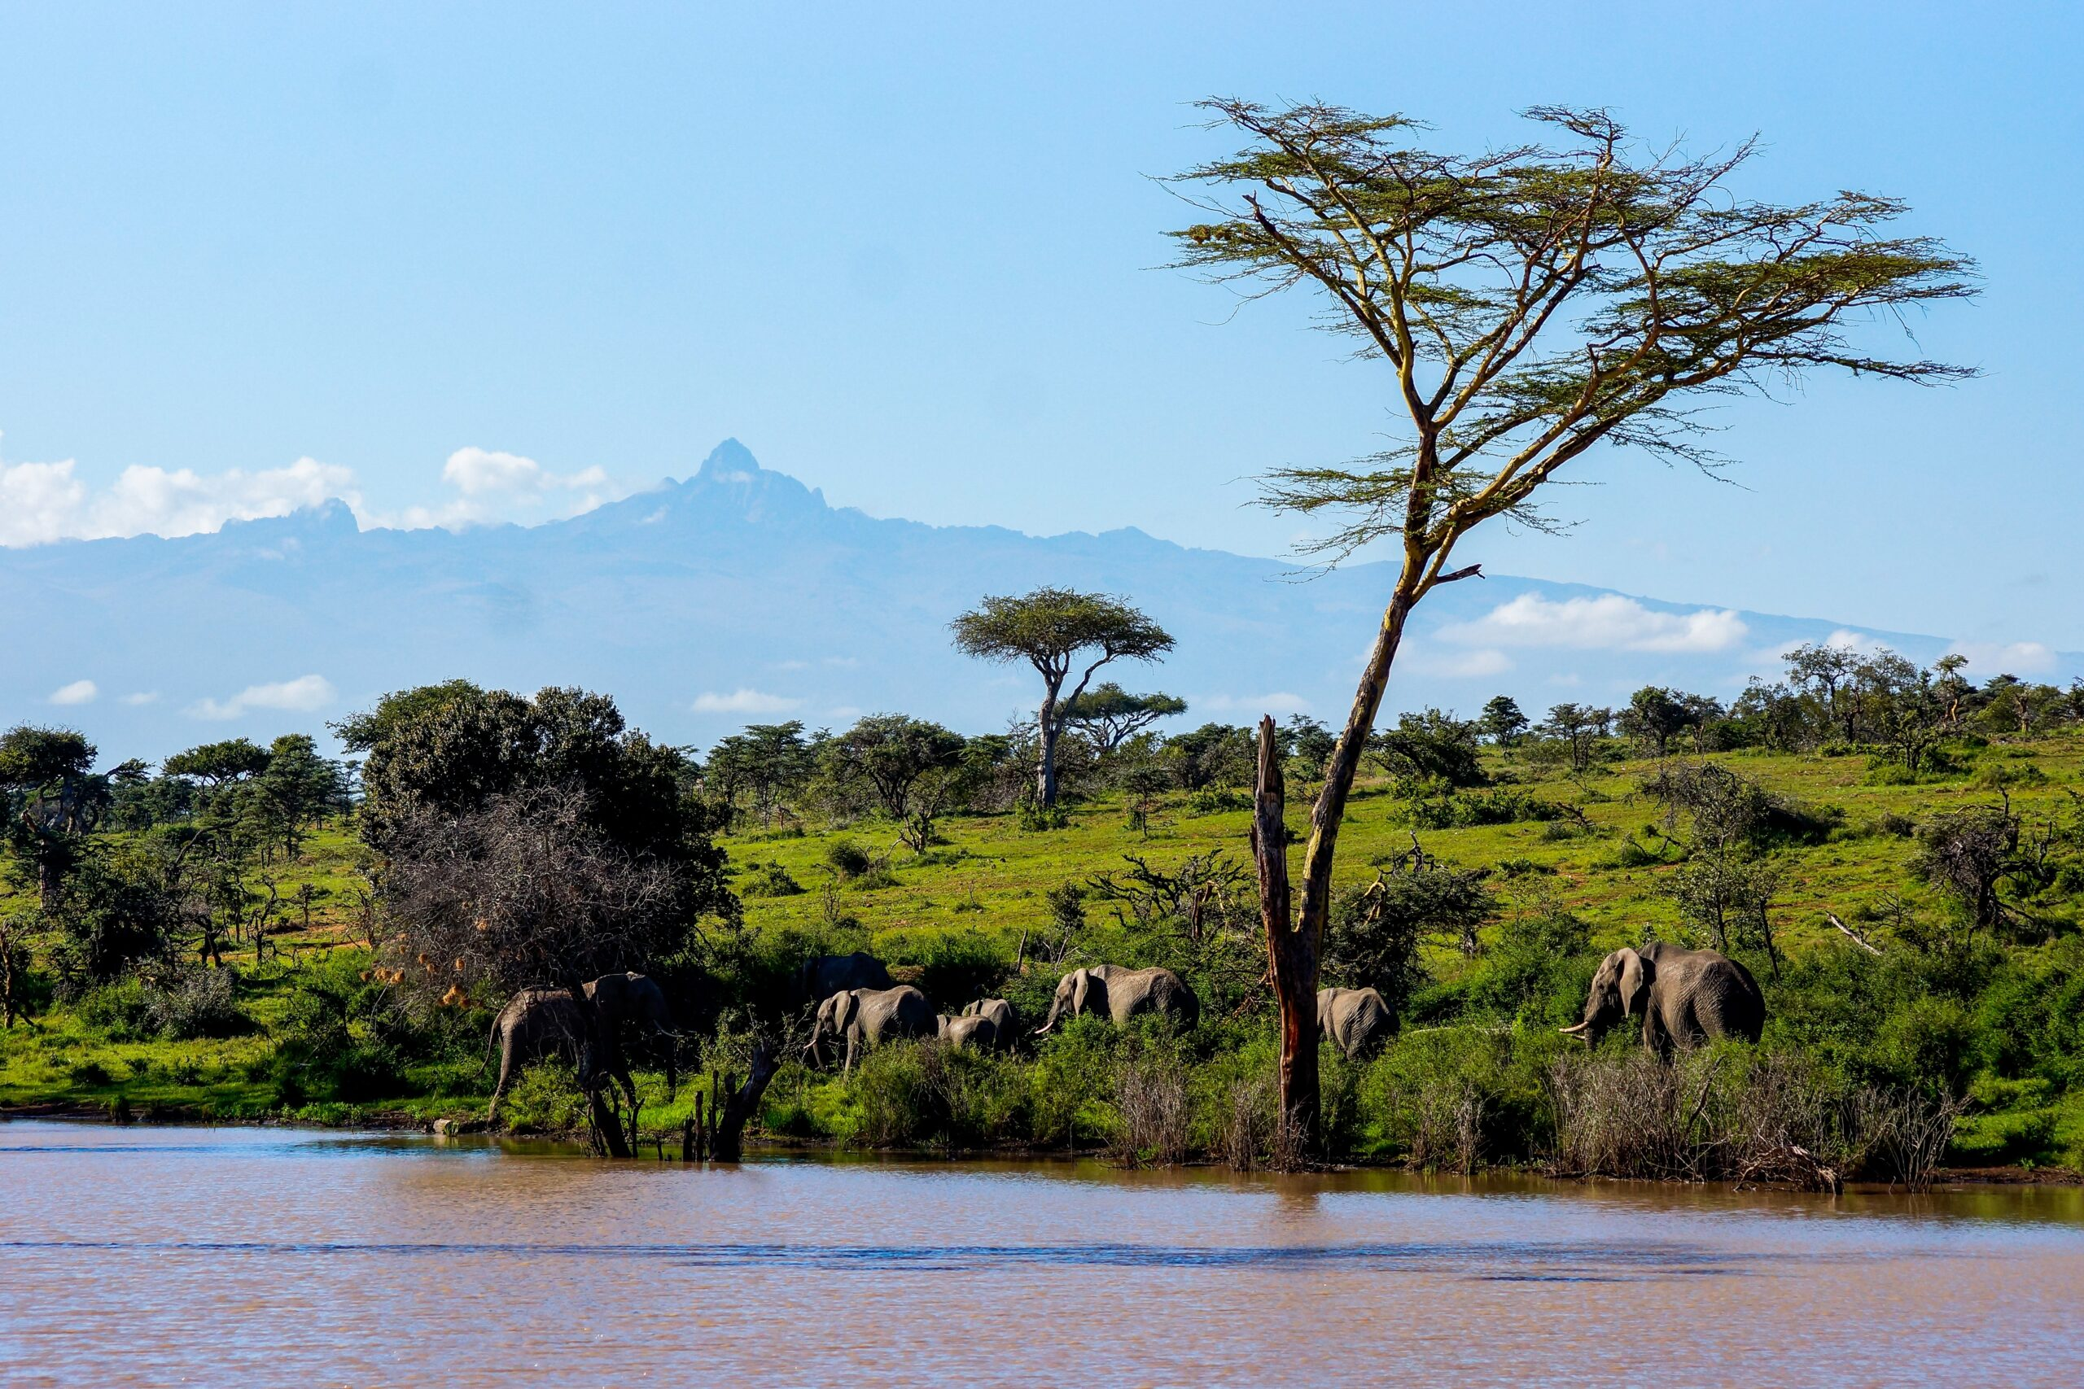
Term 1 - Secret Destination
English
Fiction writing
Adventure narrative inspired by class book The Explorer.
Non-fiction writing
Non-chronological report about a secret destination.
Guided reading
Texts linked to the secret destination.
Spellings
Following Unlocking Letters and Sounds.
Geography
Recap understanding of key geographical terms.
Study human and natural geography of a secret destination.
Music
Improvise over a drone/groove.
Compose a short ternary piece.
Listen and appraise soul music and music linked to geography.
Art
Draw 2-dimensional shapes with pencil control.
Create geometric patterns.
Maths
Place value
Including Roman numerals, reading and writing numbers up to 1,000,000, rounding, comparing and ordering.
Addition and subtraction
Including applying mental strategies, adding and subtracting whole numbers, inverse operations, rounding to check answers and multi-step problems.
Computing
Develop understanding of computer systems.
Learn about search engines.
Tamarins and Albatross
Learn together
PSHE
Learning about responsibilities, rewards and consequences.
Belief systems
Enquiry about Jewish celebrations.
Spanish
Phonics and pronunciation – recap of previous learning.
Science
Forces: gravity, friction, air resistance, water resistance.
Plan and complete investigations to develop understanding of forces.
PE
Working through the Real PE curriculum.

Slide 2
Term 1 - Secret Destination
English
Main and subordinate clause
Chronological/non-chronological ​​
Preposition​
Complex sentences​
Conjunction​
Synonym ​
Adverbials for place, manner, time
Fronted adverbial
Geography
Human features
Physical features
Climate
Culture
Landmarks
Music
Drone/groove
Ternary
Soul
Art
2-dimensional
Geometric
Pattern
Maths
Roman numeral​
Addition/subtraction​
Inverse​/commutative
Digits ​
Partition​
Strategy​
Reasoning​
Multi-step
Computing
System
Network
Search engine
Tamarins and Albatross
Learn together
Charter
Responsibility
Consequence
Rosh Hashanah
Yom Kippur
Spanish
Key Spanish sounds and vocabulary
Science
Friction
Gravity
Air/water resistance
Variables
PE
Collaboration
Resilience

