Slide 1
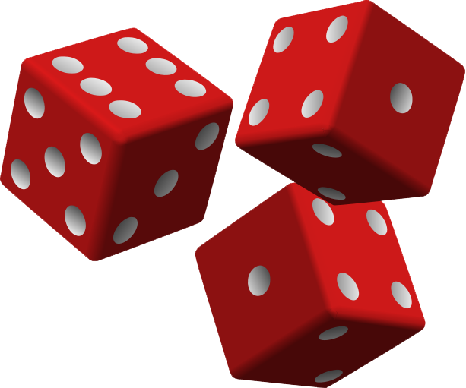


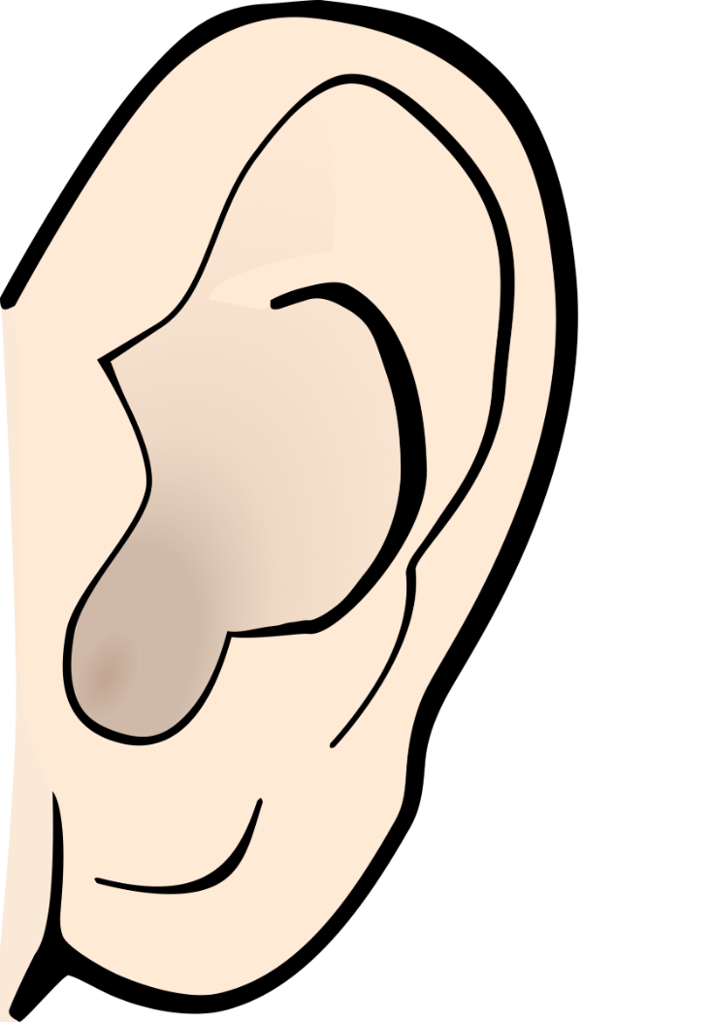
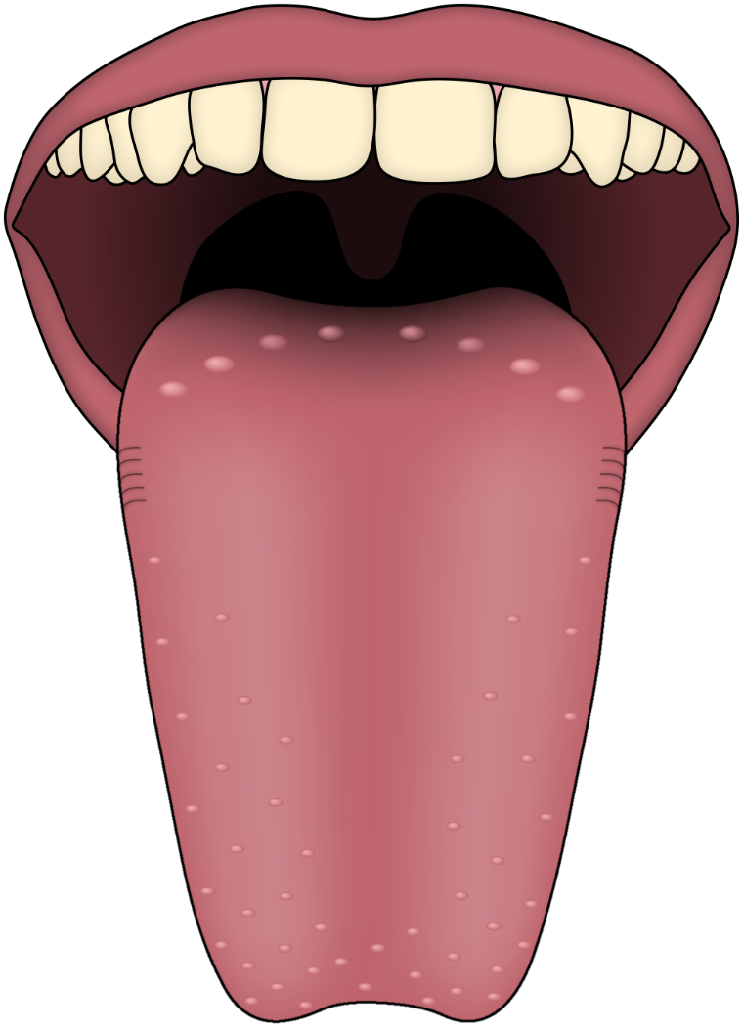
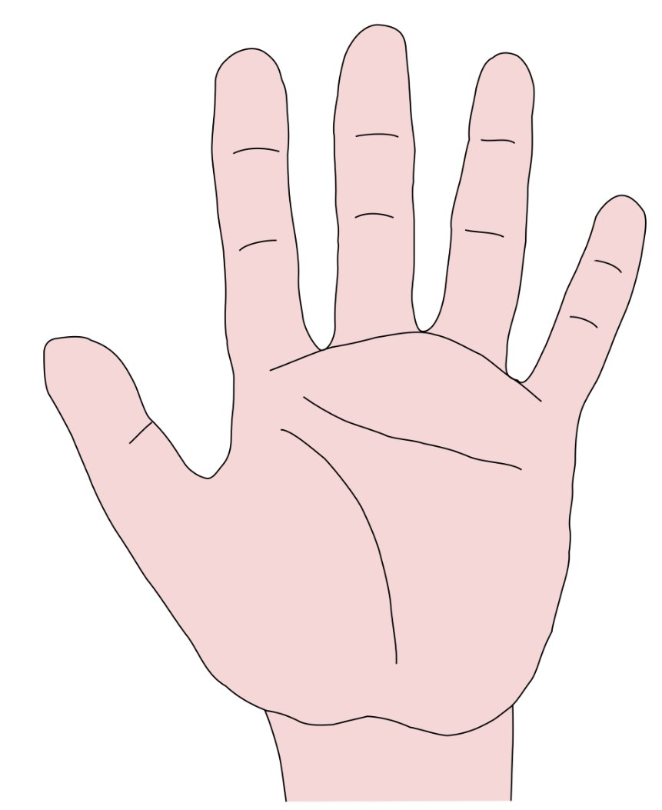




Maths
Place Value to 10
During this block, we will be teaching the children how to:
Sort objects
Count objects
Count objects from a larger group
Represent objects
Recognise numbers as words
Count on from any number
1 more/1 less
Count backwards within 10.
Compare groups by matching and compare numbers
Using vocabulary: fewer, more, same and greater than, less than, equal to
Order objects and numbers
Use a number line
Addition and Subtraction (within 10)
We will also begin to focus on some elements of addition and subtraction. This will include:
Introduce parts and wholes
Part-whole model
Write number sentences
Science
The Human Body
In Science we will be learning about the human body. We will identify, name, draw and label the basic parts of the human body.
Discover the 5 senses and say which part of the body is associated with each sense.
English
Colourful Semantics
The children will use colourful semantics to help them break down sentences and understand the individual meaning of each word and its role in the sentence. Colourful semantics can help children to better understand word order and supports them with writing super sentences.
Fiction - The Queen’s Hat
We will continue to use colourful semantics whilst looking at the losing tale – The Queen's Hat. Children will retell the story step by step.
Phonics
We will continue to learn new sounds throughout the term and apply these when reading and writing. In these lessons we will build fluency and learn how to read common exception words fluently..
Marvellous Monarchy
Year 1
Autumn Term 1
History
Key figures in history
In History, Year 1 will be learning about past and present monarchs including: King Charles III, Queen Elizabeth II, and Queen Victoria. We will also investigate objects from the past and present and take a virtual trip around Buckingham Palace!
PE
We will be developing our ability to focus and stay on task. The children will develop and apply their footwork and one leg balance through focused skill development sessions and thematic stories and games.
Learn Together – Values & Ethical Perspectives
Being Me in My World
We will develop our understanding and social emotional skills through the following units of work:
Feeling special and safe
Being part of a class
Rights and Responsibilities
Rewards and feeling proud
Consequences
Owning the learning charter
Music
Boogie Beats
We are very lucky to have Boogie Beats working with us this term to introduce music through stories and songs.
Art
Exploring and creating portraits
We will begin our learning by creating self-portraits, looking carefully at our own features and learning to draw different facial features to scale. We will explore portraits of our monarchy and generate ideas through playful hands-on, exploration of materials without being constricted towards a pre-defined outcome to create a portrait of our King.
Computing
We will be learning how to use technology around us. This will include using a keyboard and mouse and learning how to use a computer responsibly.

Slide 2
Maths
Place Value to 10
Number; zero; numbers to 10; count, forwards, backwards; how many, more, fewer, equal, group; order, largest, smallest, less; compare; equal to, greater than, less than, greatest, smallest, biggest, least, most.
Addition and Subtraction (within 10)
One more, one less, part, whole, part-whole model, add, take away, plus, subtract, minus, difference, number bond
Science
The Human body
Head, neck, body, arm , hand, fingers, leg, feet, toes, eyes, nose, tongue, ears, touch, sight, sound, taste, smell, senses.
English
Colourful Semantics
Who, doing what, where
Fiction - The Queen’s Hat
Capital letters, full stop, finger space, adjectives, repetition.
Phonics
FRED talk, special friends, speed sounds, fluency, expression
Marvellous Monarchy
Key Vocabulary
History
King, Queen, Monarch, Monarchy, past present, palace, objects, old, new
PE
Focus, movement, shape, balance, speed, style, copy, repetition, sequence, mirroring, dance, music, idea, action
Learn Together
Feelings, special, safe, rights, responsibilities, reward, proud, consequence, ownership, charter
Art
Exploring and creating portraits
Portrait, self-portrait, memorialize, subject, painting, drawing, watercolour, oil painting, pencil, colour, materials, warm, cold, emotions, collage, abstract, realistic, movement, detail, features, sketch, scale
Music
Pulse, pattern, sound, symbols, beats, tempo, clap, stomp, fast, slow, steady
Computing
Computer, technology, mouse, keyboard, track pad, safe, online

