Slide 1
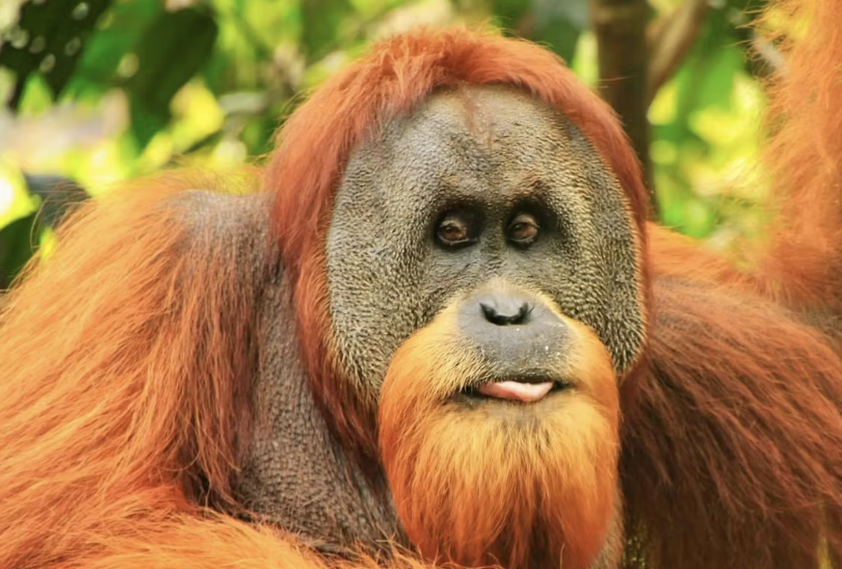

Welcome to Year 3 classes:
Bornean Orangutans and Arctic Wolves
Shawn and Katey and Louise

Slide 2
The school day routine:
8:40am Children are met by us in the entrance at the back of the school
8:45 - 9:00 am Registration in class and morning work.
9:00am Lessons will start (English and Guided Reading)
10:30am Break time.
10:45am Lessons. (Snack, Maths and Handwriting/Spelling)
12:15 – 1:15pm Lunch time.
1:15pm Afternoon sessions. (LT, Science, Geography, History, PE, Music, Art)​
3:15pm Children brought down to exit.
Assemblies are on Mondays (2.45pm), Wednesdays and Fridays at 9.00am

Slide 3
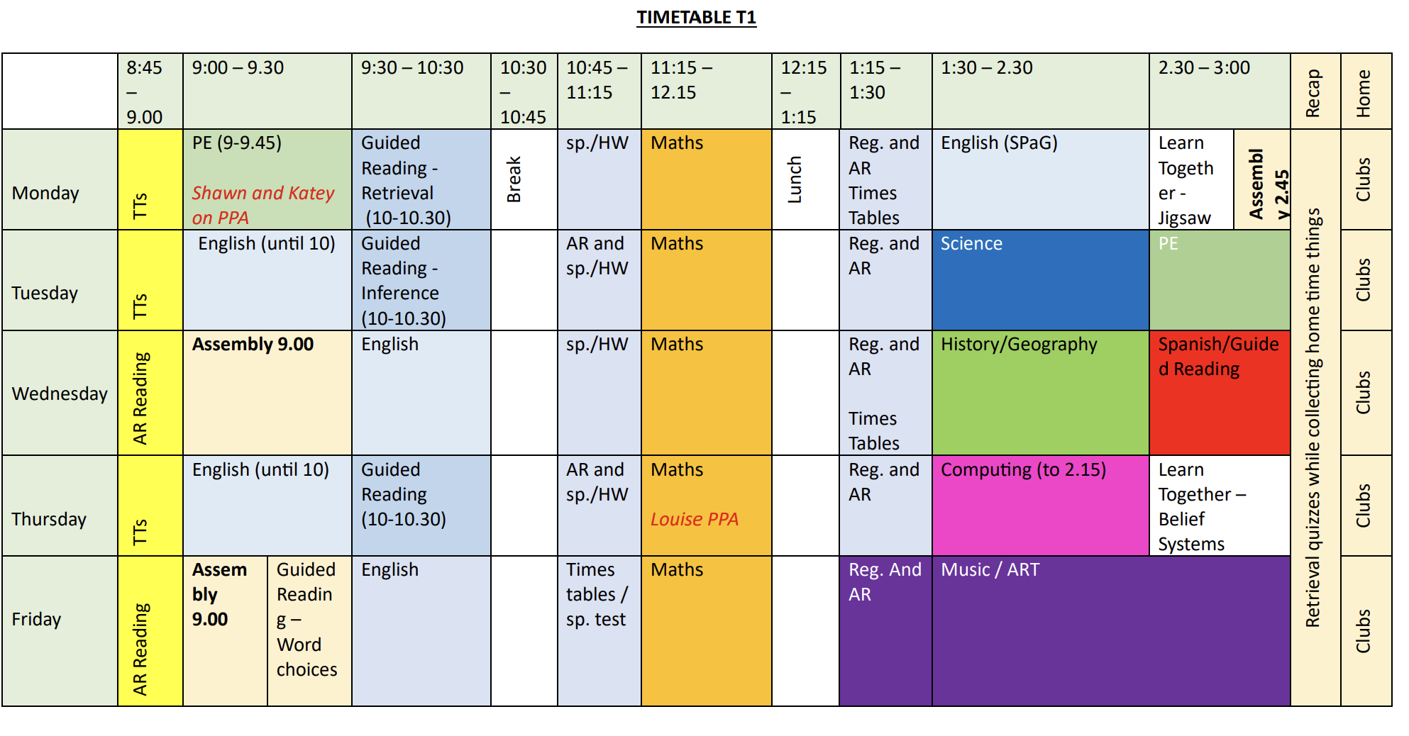
Timetable

Slide 4

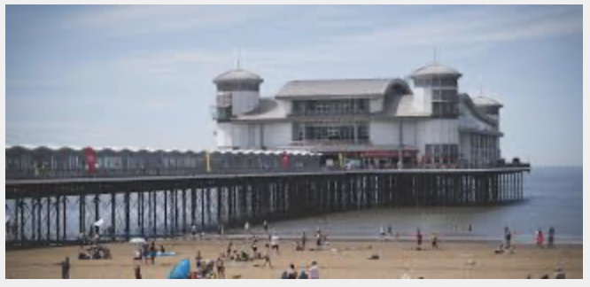
Topics
Term 1: Respecting Rainforests
Term 2: Weston’s Wonderful Piers
Term 3: Coastal Characteristics
Term 4: Rotten Roman Britain
Term 5: Wild Weather
Term 6: Angry Aztecs

Slide 5
What to bring to school:
Book bags (please keep reading books in)
Coats (labelled)
Water bottles
Pack lunch (if needed)
Appropriate seasonal clothing… e.g. wellies/sandals, wooly hats/sun hats
piece of fruit for your child to have after break time.
Children are not to bring:
Any toys or teddies from home.
We encourage children to take responsibility for their belongings

Slide 6
PE
PE will take place on Monday mornings (Lauran) and Tuesdays
Swimming will take place later in the year.

Slide 7
Our Curriculum
Learn Together – RE, PSHE, Citizenship
English writing – Talk for Writing and other writing skills processes
English Reading – AR and whole class Guided Reading. - VIPERS
Maths – White Rose
PSHE - Learn Together & PSHE Association
PE – Real PE
Languages - Language Angels (Spanish)
Music – Charanga
We are also using the White Rose Science scheme

Slide 8
Reading
We encourage all children to read as much as possible at home.
We ask that, at a minimum, you read with your child at least five times a week and make note of this in their reading log.
Reading logs are checked by us during the week
Each week your child will have their books changed once they complete their AR book.
They will be sent home one book.

Slide 9
Spellings
Spellings will be given each week.
Your child will be given spellings on a Monday and tested on the Friday.
They will have generally have spellings which will follow a specific spelling rule.
We encourage all children to practise their spellings at home as well as in school.

Slide 10
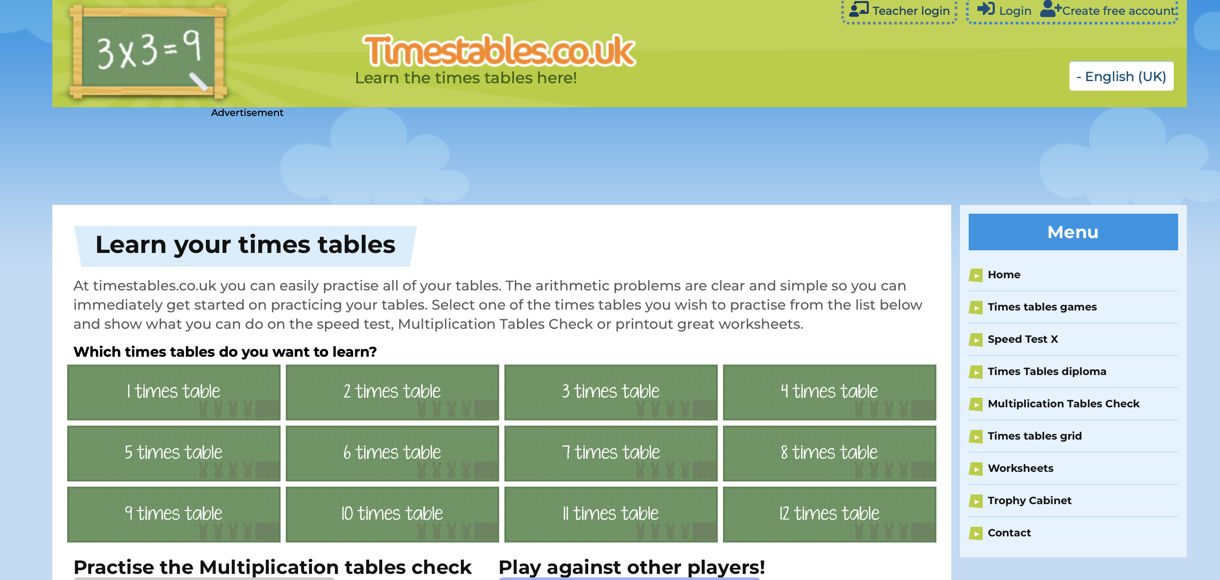

Times Tables
The times tables to be tested will be on the bottom of the spelling sheet given out on Monday.
Times tables will be tested on Friday.
We encourage all children to practise their times tables at home as well as in school.
You can practise using: TTRS or timestables.co.uk

Slide 11
Good to know:
Drinks:
After play/lunch children have 5 minutes to get a drink if they forgot at break
During brain breaks
Transition times
Toileting After play/lunch children have 5 minutes to go if they forgot at break During brain breaks Transition times

Slide 12

Behaviour Policy
READY RESPECTFUL SAFE
LOTS of positive reinforcement Say what you want to see: e.g. walk/don’t run; calm hands/stop fidgeting
Zones of regulation

Slide 13

Zones of Regulation

Slide 14
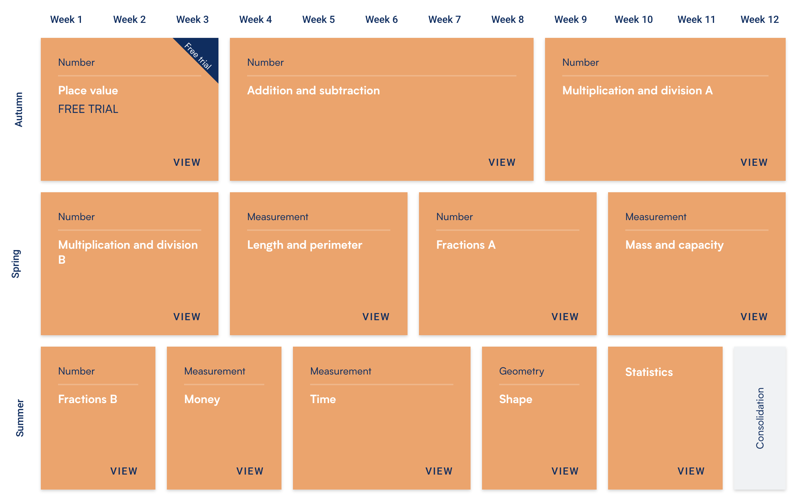
Maths Curriculum
Notes:
Numbers up to 10 million
Add and sub – 6 digits
Multiply – 4 x 2
Long division – 2 digit number eg 13

Slide 15

Absences
If your child is unwell/has an appointment/exceptional circumstance, please let the office know as soon as you can
If you want any work during long-term absences, please email class teacher.

Slide 16

Dates for Diary
21st and 23rd October - Parents Evening
Wednesday 3rd December - Weston Museum coming in to work with the children about our topic
3rd and 5th February - Parents Evening
Thursday 12th March - Roman Centurion Day! Exploring a Roman camp and working with a Roman Centurion

Slide 17
Contact
School email:
info@parklandset.org.uk
No longer class emails.
School phone number: 01934 404555

Slide 18

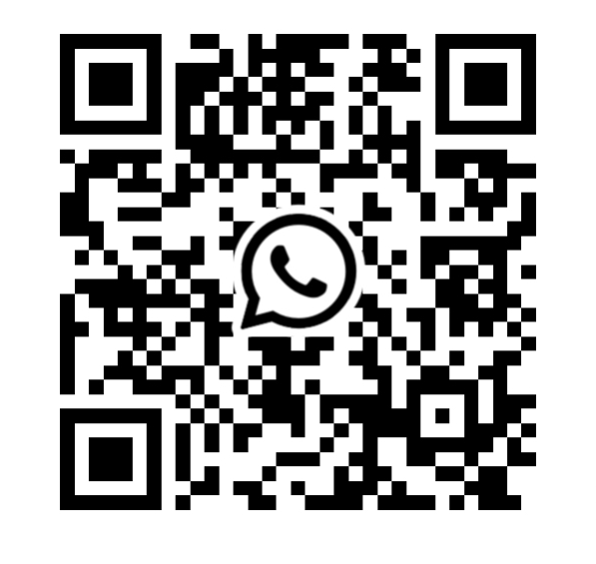
We are the Parent, staff association for Parklands Educate Together
We work as a team to put on events and fundraising occasions
Events we run:
October Disco
Summer Fair
Summer Raffle
Easter trail
Christmas Crafternoon
And anything else we can try too!
We are looking for new members to join our organising committee to help run and organise these events so that we can increase our fundraising efforts further!!
Please join our WhatsApp announcement stream via this QR code to get updates from us such as event announcements! You can also respond back to us directly also!
Already we have managed to fundraise successfully for the school stage, extra equipment in forest school, extra lunch time resources and gifts for the children throughout the year!!

Slide 19
Any questions?

