Slide 1
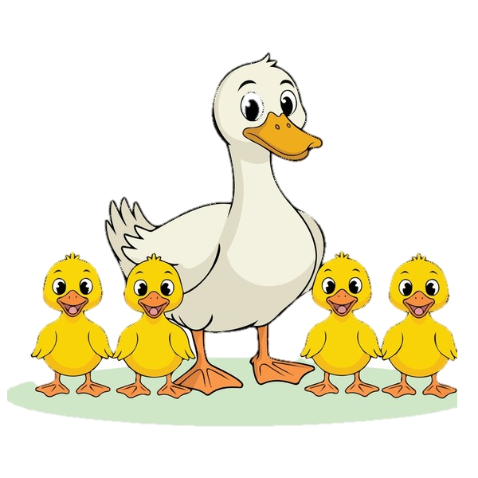
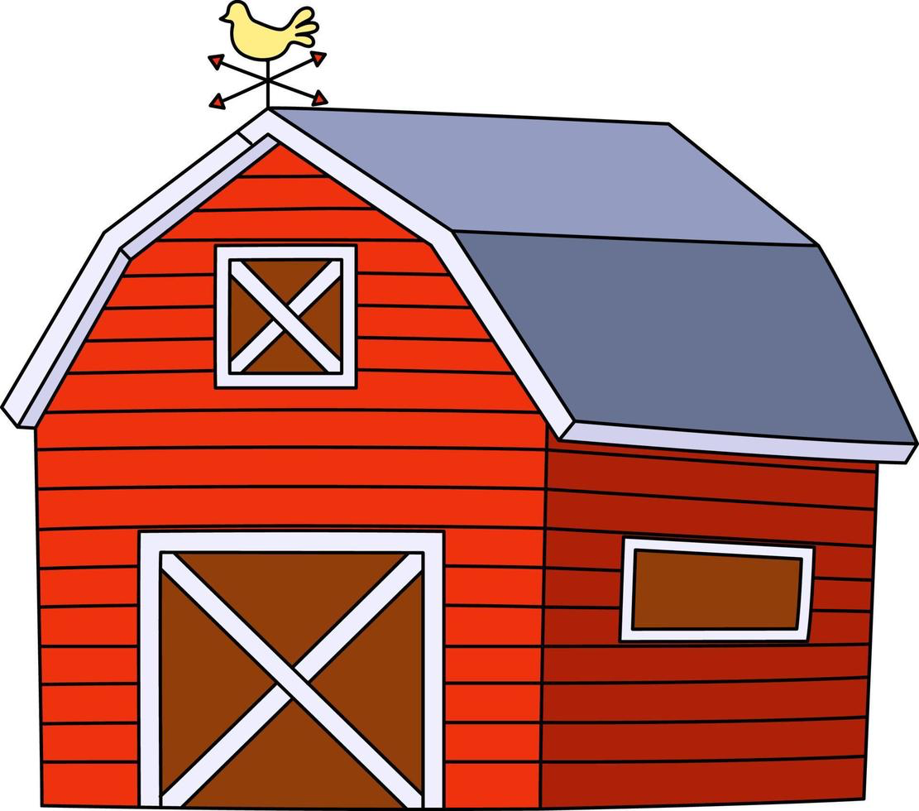
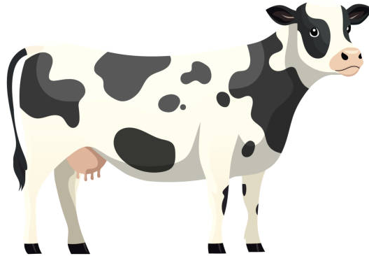
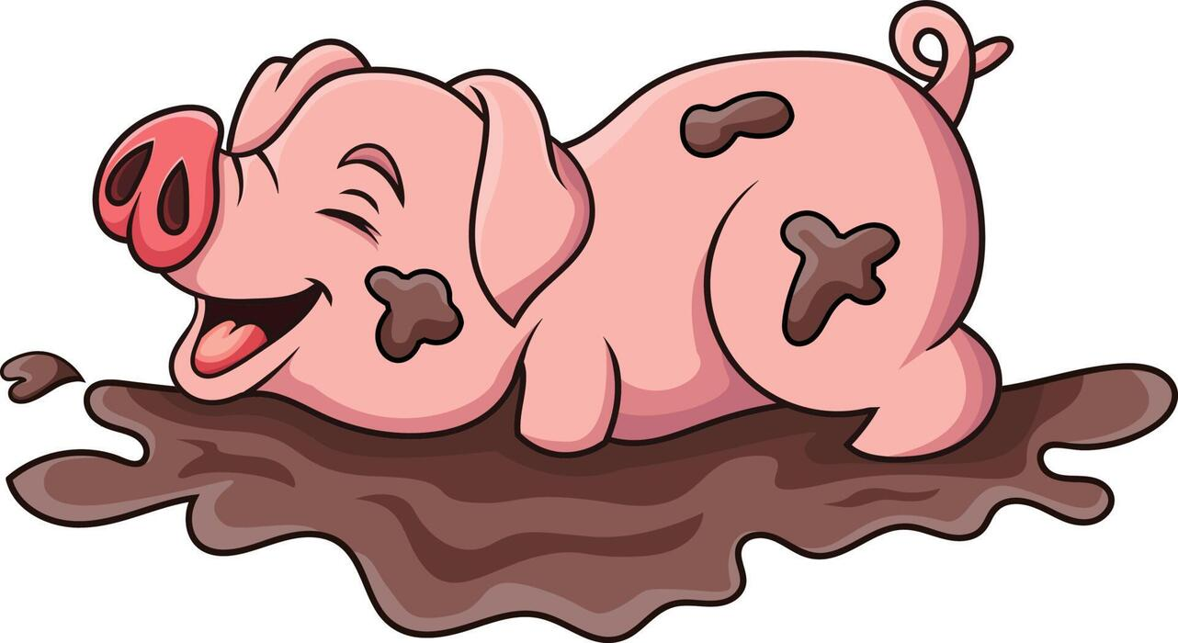
Literacy
As writers we will be exploring the text: What the Ladybird Heard and The Enormous Turnip. The children will be starting to independently write simple captions and working in increased independence.
In Phonics the children will be mastering Phase 3 sounds, writing words using these sounds and reading words independently.
Personal, Social and Emotional Development
We will work on:
Recognising and discussing our feelings
Discussing how to be a good friend
Helping people in need
Taking turns and sharing
Dealing with conflicts
Maths
As Mathematicians we will be learning about the numbers 8 and 9 as well as focusing on making, forming and gaining a deeper understanding of numbers to 5 and beyond.
The children will be starting to explore. Numebr bonds to 10 and use part whole models.
We will be starting to explore length through growning plants as well as exploring cpapcity through water play.
Spring 2
Down on the Farm
Understanding of the World
We will develop our skills by.....
Growing beanstalks
Looking at lifecycles
Exploring signs of Spring
Investigating animal offspring
Visiting Court Farm
Communication and Language
As communicators, we will be developing our speaking and listening skills. Children will be retelling stories, offering opinions and sharing facts as well as answering questions about what we have read. We will be focusing on what makes a question.
Expressive Arts and Design
As Artists we will be:
Singing familiar songs
Moving rhymically
Exploring sounds and instruments
Drawing and painting
Exploring a range of mark making tools
Exploring the role play and small world areas to ignite our imagination.
Physical Development
To develop our skills we will...
Practise writing our names
Play finger strength games such as finger freeze
Use using cutlery with independence
Find different ways to move
Look at how exercise effects our body
Practise how to use a range of tools effectively and safely such as scissors.
Write independently during continuous provision
Learn Together
This term we will be starting our RE scheme of work, looking at the changes in Spring and the Christian celebration of Easter.

Slide 2

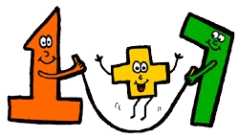





Literacy
Description
Clues
Adjectives
Museum
Histroy
Modern
Past
Present
Traditional
Country
Clockwork
Electric
Push
Pull
Wind up
Motor
Vocabulary
Spring 2
Maths
Subitise
More and Less
How many?
On top
Under
In front
Behind
Next to
Circle
Square
Triangle
Rectangle
Pentagon
Cube
Sphere
Cuboid
Pyramid
Build and Construct
Number Bonds
Part Whole
How to make 10
1 more 1 less
Topic Words
Farm Milk Tractor Chick Horse Chicken Goat Donkey
Pig Calf Pond Sheep Barn Duckling Duck Farm Shop Wheat Fabric Field Grow Pig Sheep Lamb Crops

