Slide 1
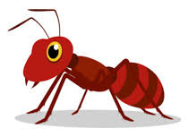
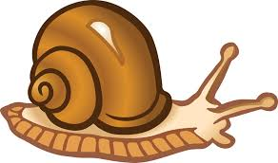
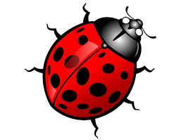

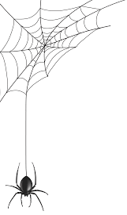
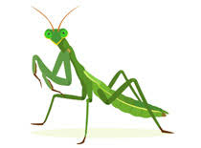
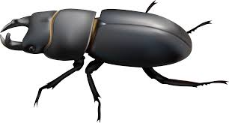
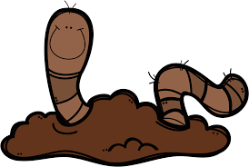
Literacy
In literacy we will be exploring the stories of Norman the Slug with the Silly Shell and Walter‘s Wonderful Web. As writers, we will look at description, fact files, sequencing and instructions!
We will also be exploring poetry and the use of rhyming words. This will be whilst reading the poetry book Mad About Minibeasts. Non-fiction books will also play a big part in our finding out about bugs.
Personal, Social and Emotional Development
We will work on:
Being kind and respectful
Taking turns and sharing
Listening and responding approrpiately to others
Appropriately adjusting our behaviour to different situations
Trying new things
Maths
As mathematicians, we will continue with recognising numerals to 10 and beyond and focus on forming numbers correctly.
We will begin to explore doubling and halving using a range of practical activities.
We will be introducing subtraction into our practical maths activities and exploring writing our own subtraction number sentences.
What’s That Under the Log?
Understanding of the World
We will be:
Exploring the lifecycles.
Creating bug hotels.
Going on minibeast.
Thinking about how we can look after our environment.
Using technology to take pictures.
Commuication and Language
We will continue to develop our speaking and listening skills through giving polite instructions, sequencing events and being minibeast researchers! The children will work in talk partners and groups to share their own news. Children will be encouraged to research facts about minibeasts and to share their knowledge with their friends in the role play, small world and reading areas.
Expressive Arts and Design
As artists, we will be refining and exploring our skills with a range of different media. We will have a focus media each week such as powder paints, water colours and charcoal.
As part of our topic, we will link our skills to different minibeasts, creating different patterns, textures and models!
The Learn Together strands we will be focusing on are:
Ethics and the Environment
Equality and Justice
As environmentalists, we will begin to explore things such as deforestation, global warming and plastic pollution, looking at the impact this is having on our world.
We will explore empathy and Justice through our value of the term!
Physical Development
We will be:
Developing fine and gross motor skills
Getting ourselves undressed and dressed for PE
Exploring large and small movements
Exploring how to use tools safely
Thinking about healthy and unhealthy foods!

