Slide 1

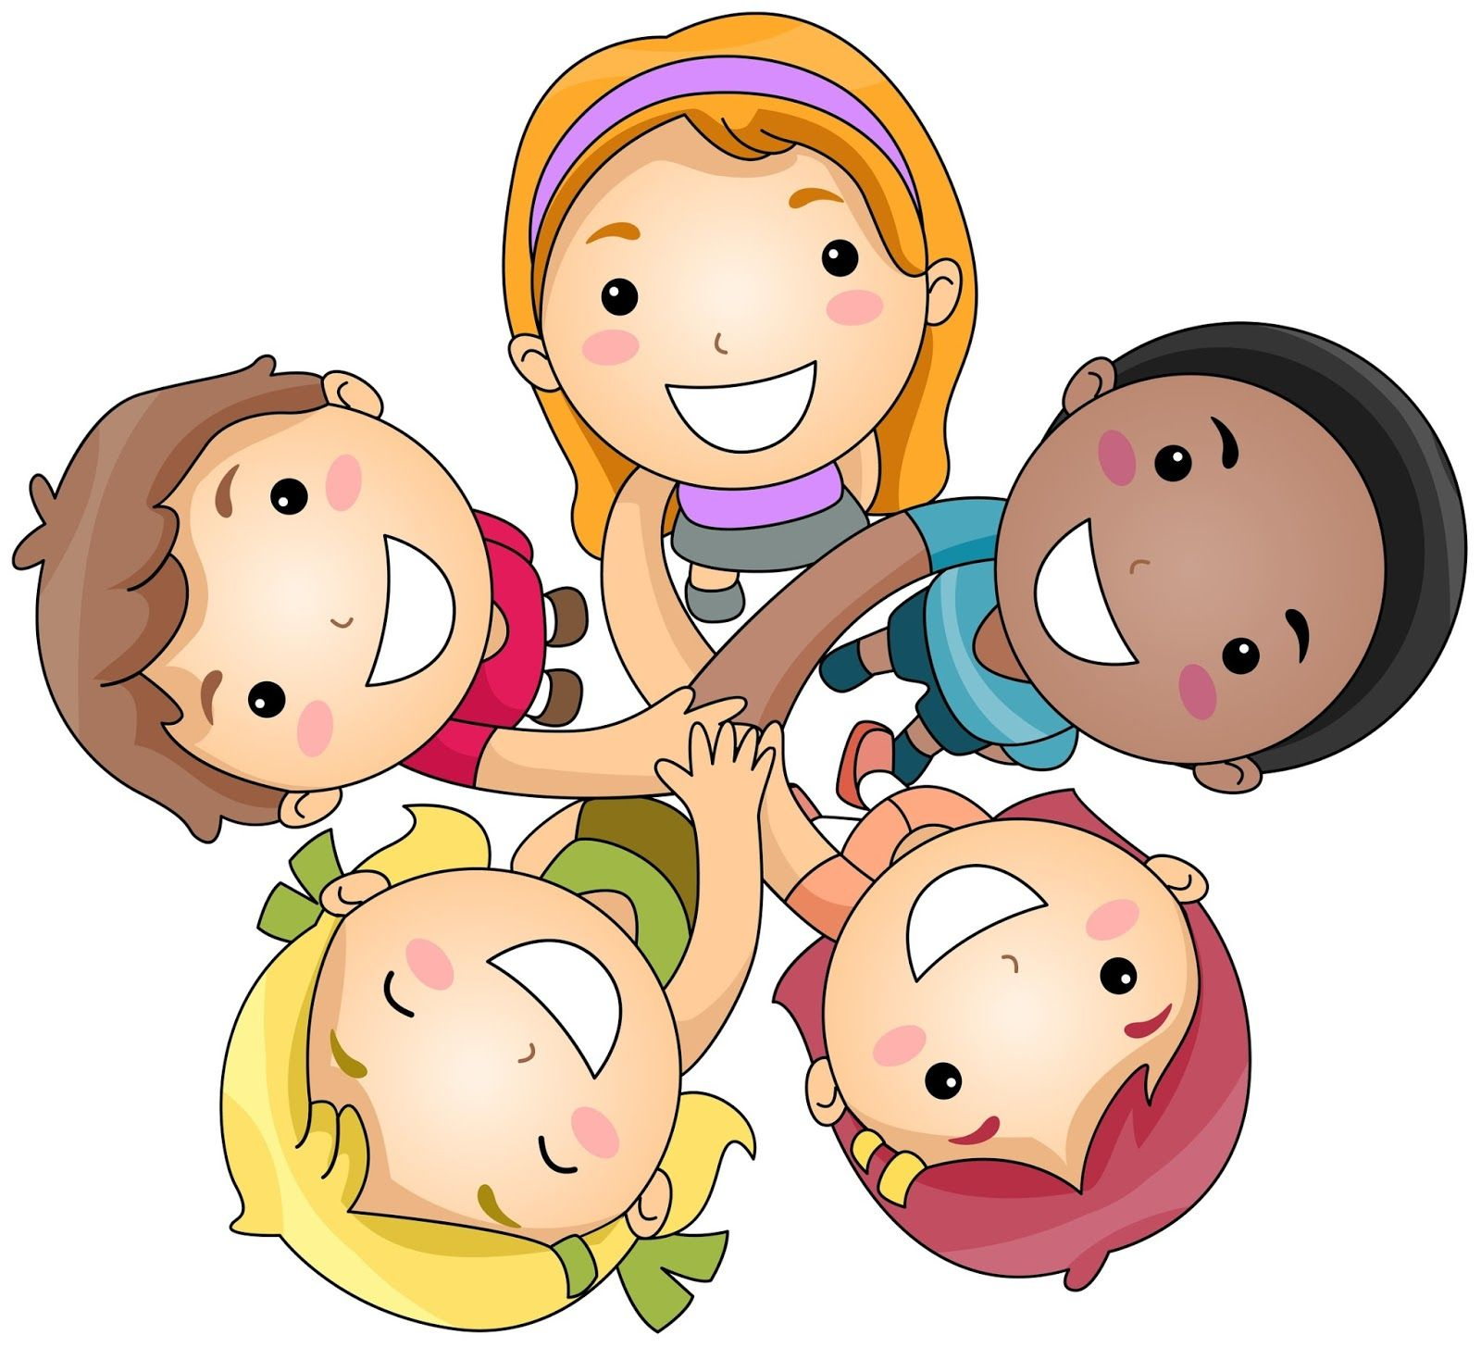
Literacy
As writers we will be exploring the text 'The Colour Monster' where we will be describing feelings and characters, creating story maps and retelling stories.
We will play some oral segmenting and blending games with our class phonics puppet, Fred, and we will begin to learn some set 1 sounds following the phonics programme Read Write Inc (RWI).
Personal, Social and Emotional Development
We will work on:
Recognising and discussing our feelings
Discussing how to be a good friend
Helping people in need
Taking turns and sharing
Dealing with conflicts
Maths
As Mathematicians we will be learning about:
Spatial reasoning
Positional langauge
Directional language
Construction and both 2D and 3D shapes
Subitising numbers 1, 2 and 3.
We will be singing lots of nursery rhymes and will have counting as part of our daily routine.
Autumn 1
Knowing Me, Knowing You!
Understanding of the World
We will develop our skills by.....
Exploring different occupations and professions.
Identify similarities and differences between ourselves and others.
Exploring the natural world around us.
Communication and Language
As communicators, we will be developing our speaking and listening skills. Children will be retelling stories, offering opinions and sharing facts as well as answering questions about what we have read. We will also learn some makaton signs such as “Good morning“.
Physical Development
To develop our skills we will...
Practise writing our names
Play finger strength games such as dough disco
Begin to use RWI mnemonics to support letter formation
Explore healthy and unhealthy food
Practise using cutlery
Find different ways to move
Look at how exercise effects our body
Practise how to use a range of tools effectively and safely such as scissors.
Expressive Arts and Design
As Artists we will be:
Singing familiar songs
Moving rhymically
Exploring sounds and instruments
Drawing and painting – using mirrors to create self portraits
Exploring a range of mark making tools
Exploring the role play and small world areas to ignite our imagination.
The Learn Together strands we will be focusing on are:
Equality and Justice
Moral and Spiritual
Value of the month

Slide 2

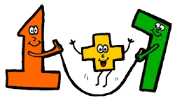
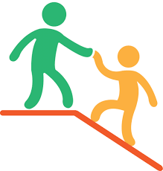

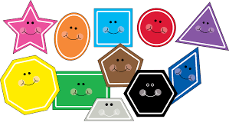


Literacy
Describe
Adjectives
Label
Sentence
Finger spaces
Capital letter
Full stop
First
Next
Suddenly
Then
Finally
Blending
Segmenting
Vocabulary
Autumn 1
Maths
Subitise
More and Less
How many?
On top
Under
In front
Behind
Next to
Circle
Square
Triangle
Rectangle
Pentagon
Cube
Sphere
Cuboid
Pyramid
Build and Construct
Left
Right
Forwards
Backwards
Topic words
Myself Happiness Unhealthy
Others Sadness Support
People Anger Care
Likes Worried Responsibility
Dislikes Nervous Respect
Emotions Excited Friendly
Feelings Healthy Caring
Family Friends Experience

