Slide 1
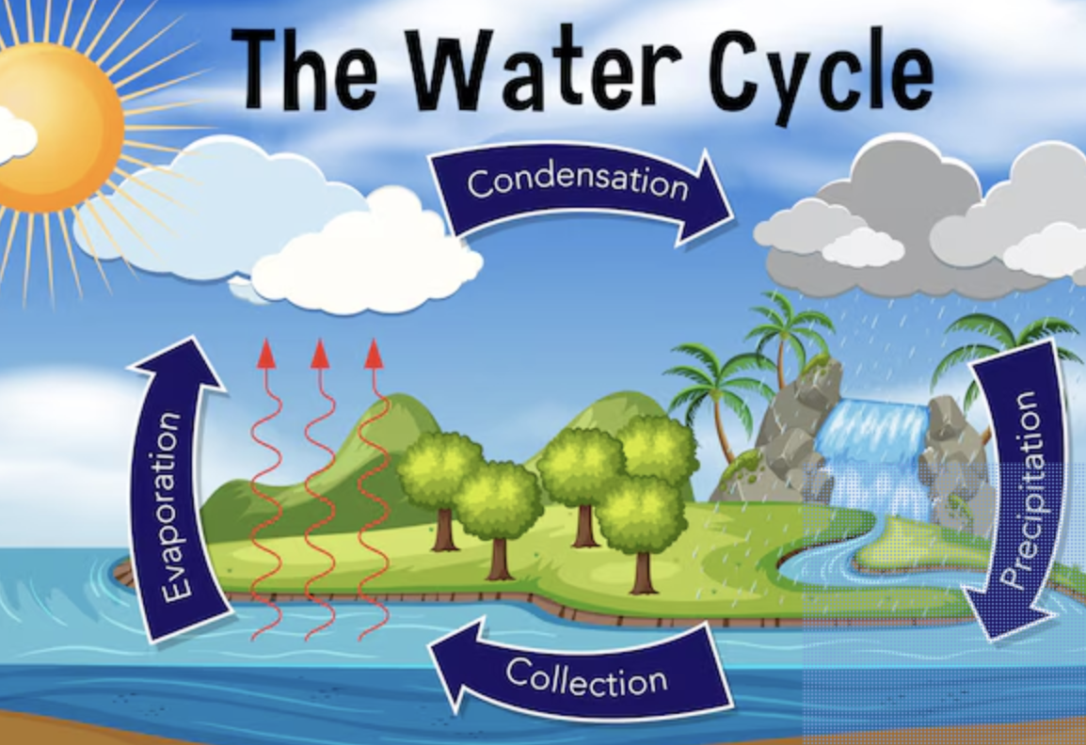
Water, Water everywhere.
English
Review and recap.
Reading (guided and accelerated reader).
Non-fiction writing
Write a newspaper article about somerset flooding.
Diary writing
- Write a diary entry from a characters perspective.
Spellings
Familiarise with Year ¾ spellings.
Science – Electricity
What do we use that uses electricity?
Basic components of a circuit
- Conductors and insulators
Experiment: problem solving and making effective circuits.
Music
Music structures
PE
Working through the Real PE curriculum on a Monday.
Learn together
Focus this term: Healthy Me
Includes: my friends and me, Group dynamics. Smoking, alcohol, healthy friendships and celebrating my inner strangths
Maths
Fractions
-Count beyond 1 whole.
Partition mixed numbers
Compare and order mixed numbers
Improper fractions
Add and subtract fractions.
Decimals
Linking fractions and decimals.
Belief Systems
Buddhism – The story of Buddha, linking this to happiness.
Geography
Water Water everywhere
Wa​ter cycle
Flooding (case study)
Computing
Data Collection
- Focus on problem solving and programming using ICT.
MFL- Spanish
Speaking, reading, and writing practice.
- Focus on home and classroom.

Slide 2
Water, Water Everywhere!
English
Tenses
Preposition
Complex sentences
Conjunction
Direct speech
Personification
Pronouns for cohesion
Similes
Expanded noun phrases
Fronted adverbials with a comma
Science – Electricity
- Circuit
Electricity
Battery
Cell
Conductor
Watts
Amps
Music
Harmony
Melody
Tempo
Rhythm
Compose
PE
Teamwork
Effort
Focus
Strategy
Challenge
Maths
Width
Fraction
Whole
Unit fraction/non-unit
Mixed number
Improper fraction
Hundredths
Tenths
Computing
Programming
Code
Scratch
Pixels
Optimise
Geography
Human geography
Natural geography
Compare and contrast
MFL- Spanish
Una casa, un piso, ciudad, campo, cocina and un dormitorio
Learn together
Integrity
Honesty
Morality

