Slide 1
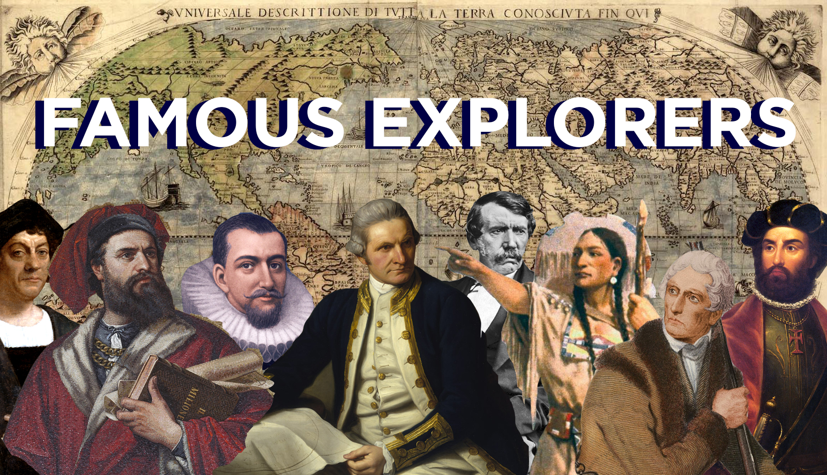

Full Steam Ahead!
English
Review and recap Year 4 grammar. Introduce Year 5 grammar.
Reading (guided and individual).
The Explorer by Katharine Rundell
Create a journey tale inspired by our class text.
Create a diary entry about going on an exciting adventure.
Non Chronological Report on Tudor Explorers
Spellings
Familiarise with Year 5 spellings.
Improving use of dictionaries and thesauruses.
Science – Forces (gravity, air resistance and water resistance)
Identify forces such as pushes and pulls
Explain gravity as a force and investigate Newtons theory of gravity
Explain the effects of friction, including air and water resistance
Identify different mechanisms
Music
Focus on learning lyric and singing as a class.
Understanding beat, pitch and tempo.
PE
Real PE - cognitive Cog.
Maths
Place value
Roman numerals to 1,000
Reading and writing numbers to 1,000,000
Powers of 10
Compare, order and round numbers to 1,000,000
Addition and subtraction
Multi-step problems and word problems
Adding and subtracting whole numbers with 4 digits
Computing
We are animators!
- Refamiliarising with Scratch to create and share a simple animation.
Tamarins and Albatross Term 1
History – Explorers
- When did Europeans start to explore?​
-Why did explorers travel?​
-Who was Christopher Columbus?​
-Who was Sir Francis Drake?​
-Who was John Cabot?​
-What was the impact of the European explorers?
Art
Mark making
Creating a Jungle Animal lin ked to our explorer topic
Learn together and AOTW
Focus this term: Responsibility and respect
Friendship, responsibility, class culture.

Slide 2
Key words
English
Chronological/non-chronological
Subordination
Preposition
Complex sentences
Conjunction
Synonym
Place, manner, time, adverbial
Fronted adverbial
Science – Forces (gravity, air resistance and water resistance)
- Friction
Gravity
Mechanisms
Resistance
Variables
Prediction
Music
Harmony
Melody
Tempo
Rhythm
Compose
PE
Teamwork
Effort
Focus
Strategy
Challenge
Maths
Sum
Roman numeral
Addition/subtraction
Inverse
Digits
Partition
Strategy
Commutative
Reasoning
Multi-step
Computing
Programming
Code
Scratch
Pixels
Optimise
Tamarins and Albatross Term 1
History
Chronology/era
Civilisation
Artefact
Invasion/conquest
Kingdom
Collapse
Art
Mark making
Pressure
Direction
Shade
Learn together
Respect
Responsibility
Friendship
Resolution

